Slide 1








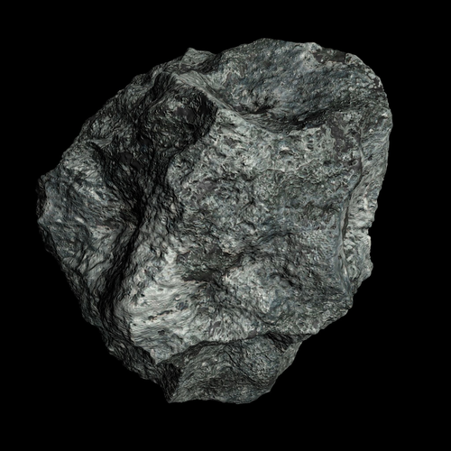
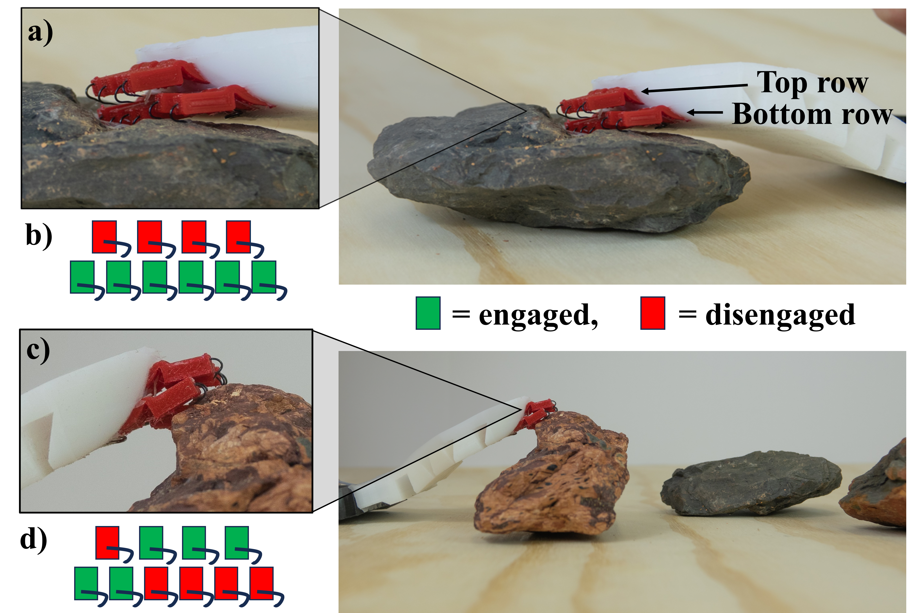
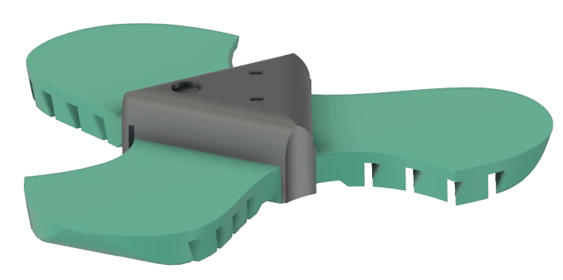
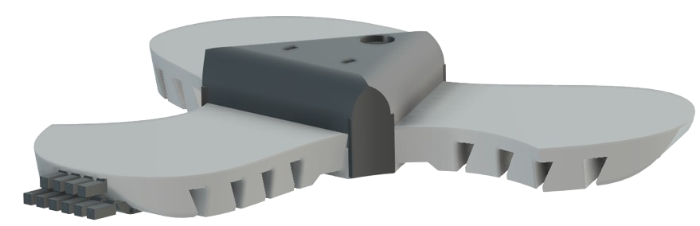
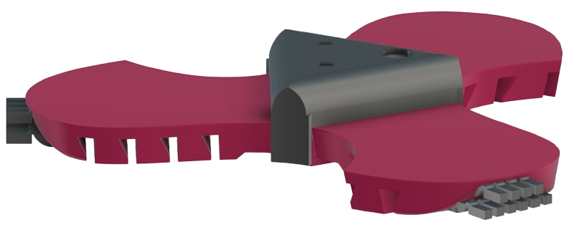
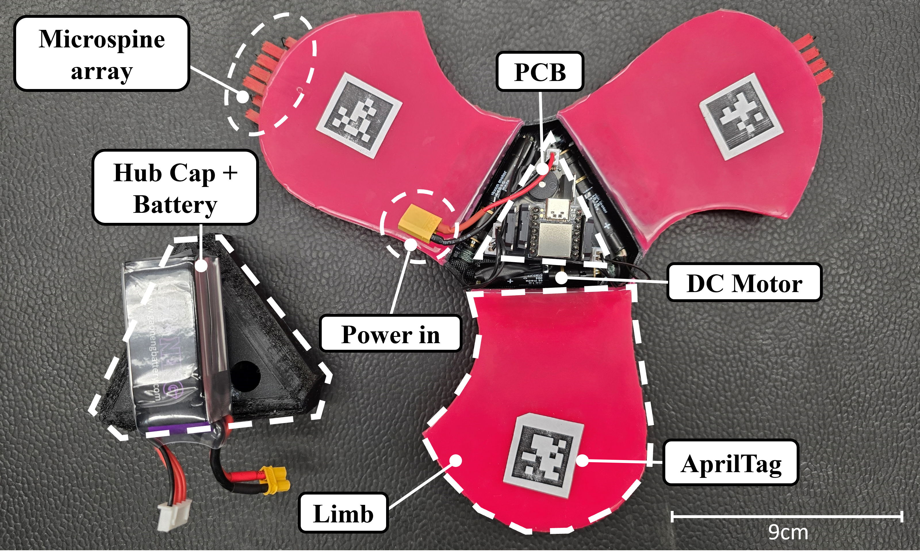
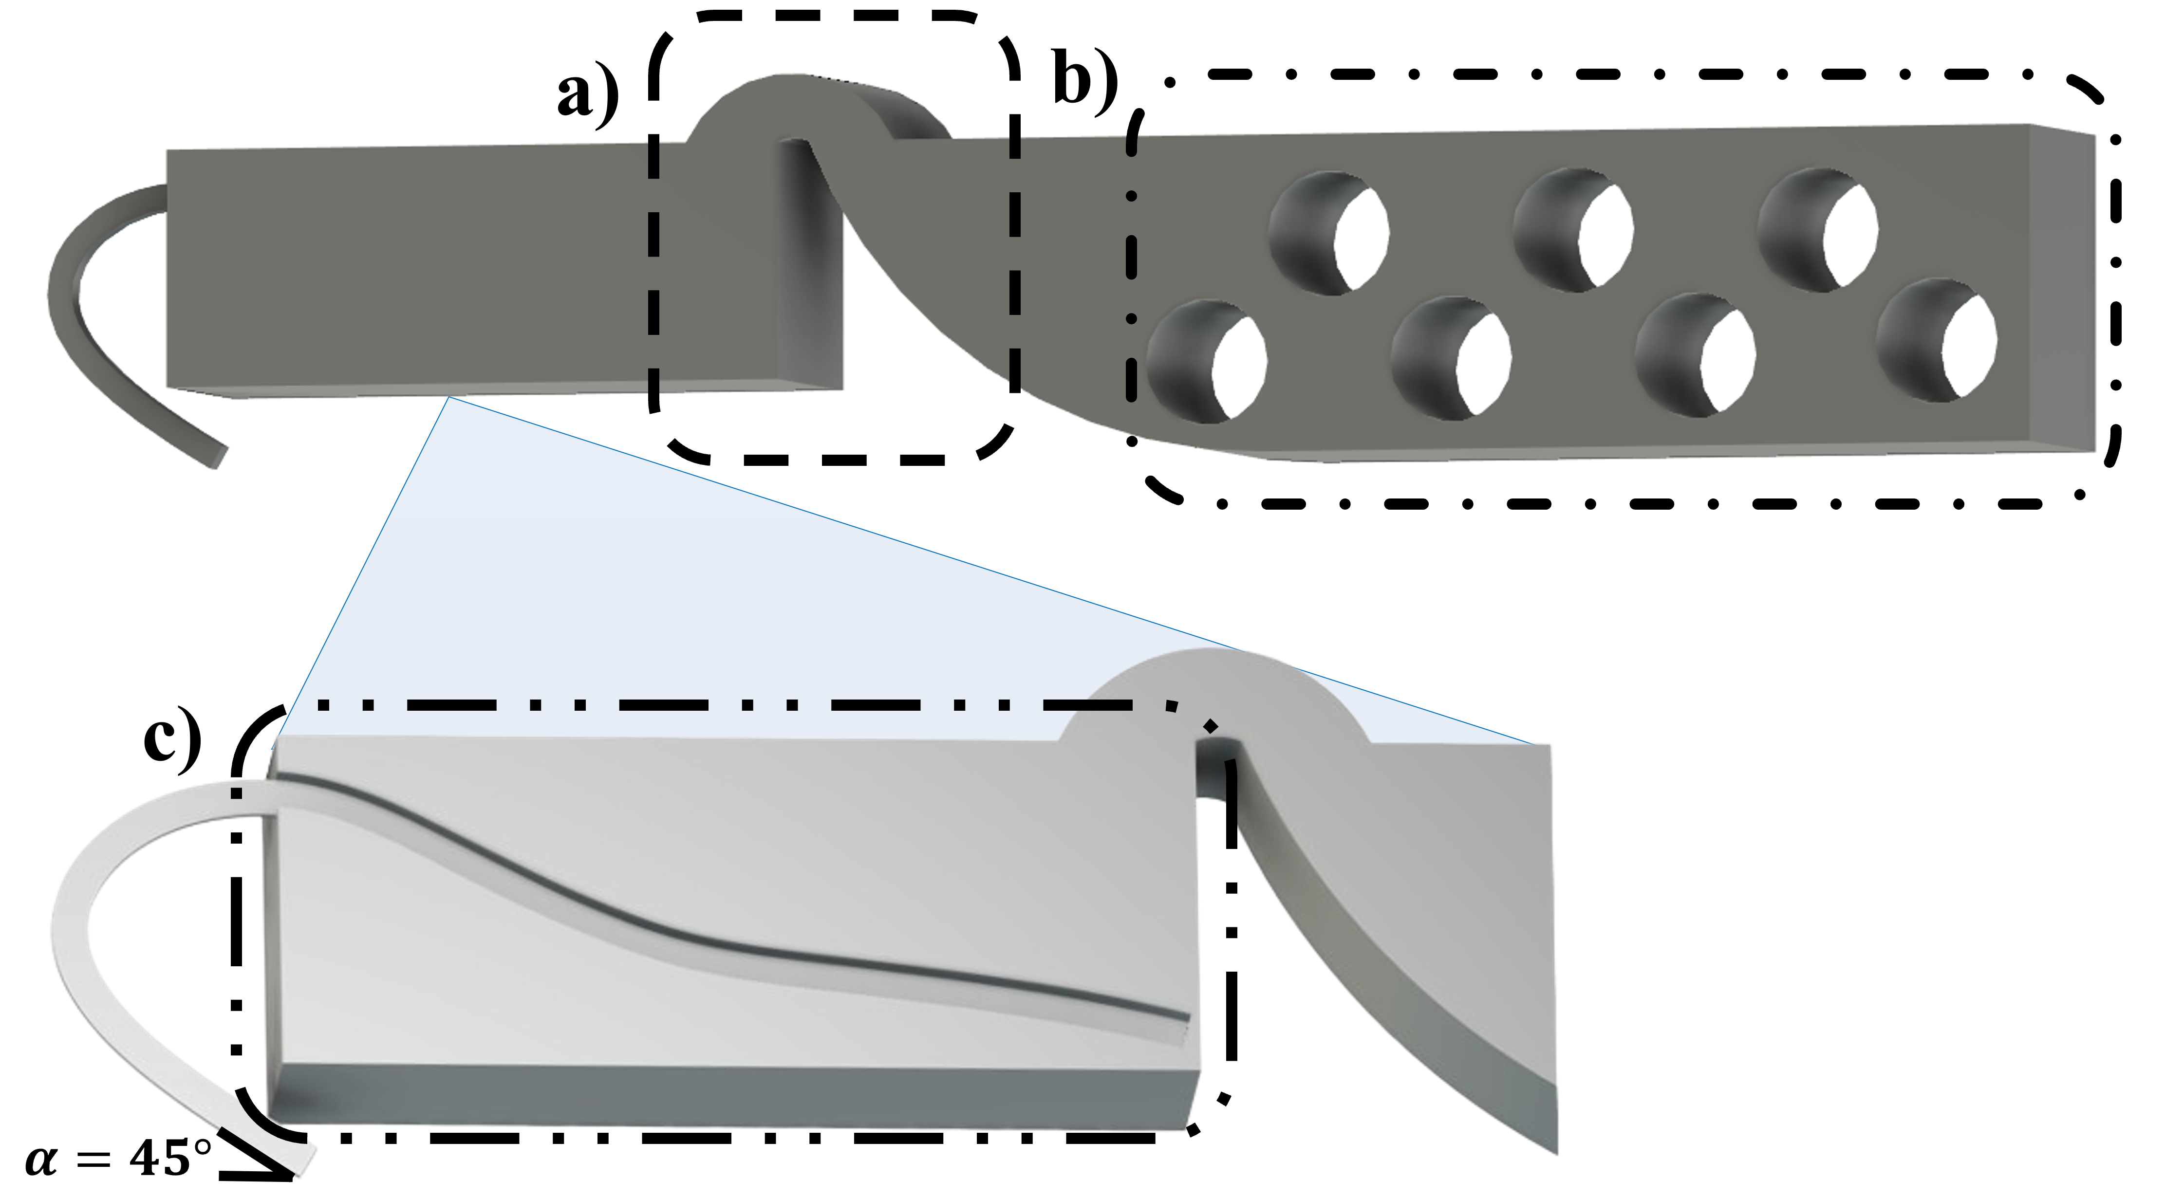
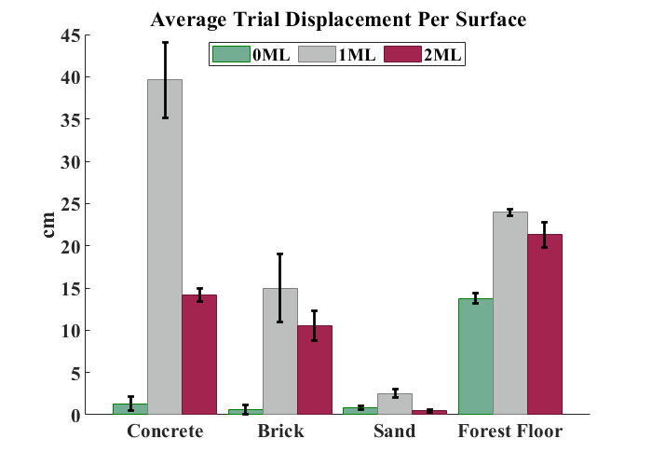
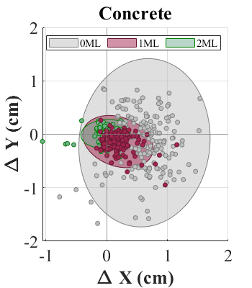
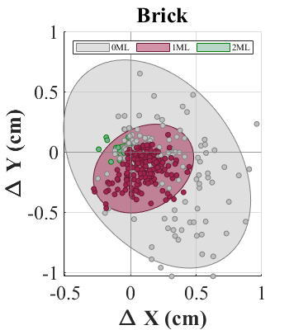

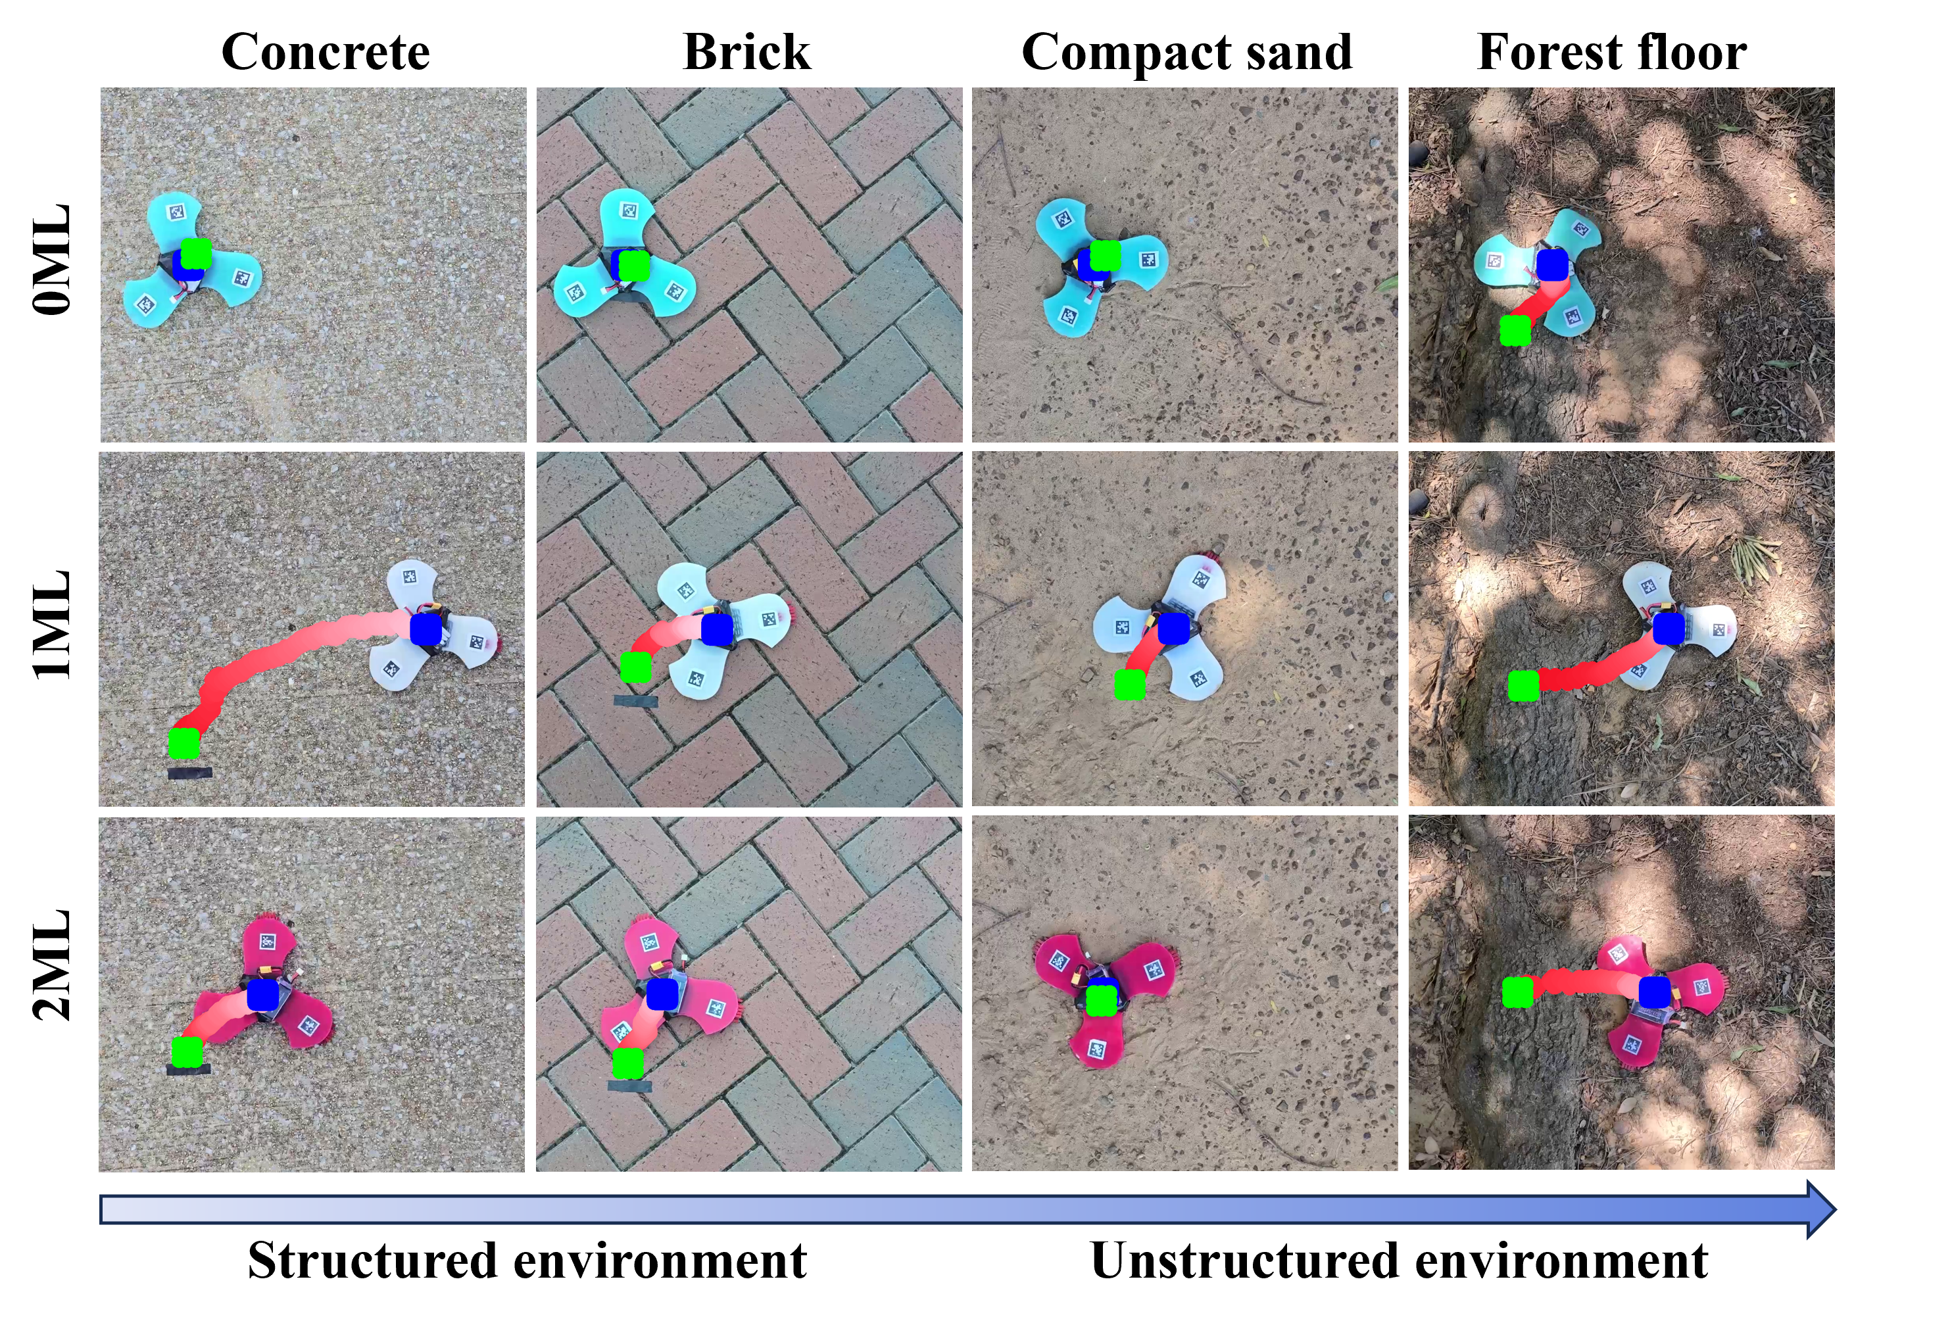
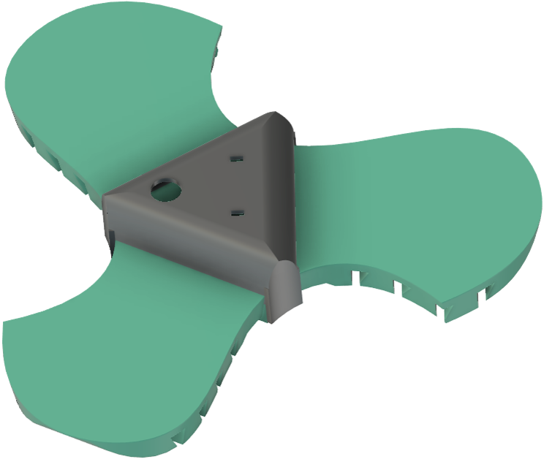
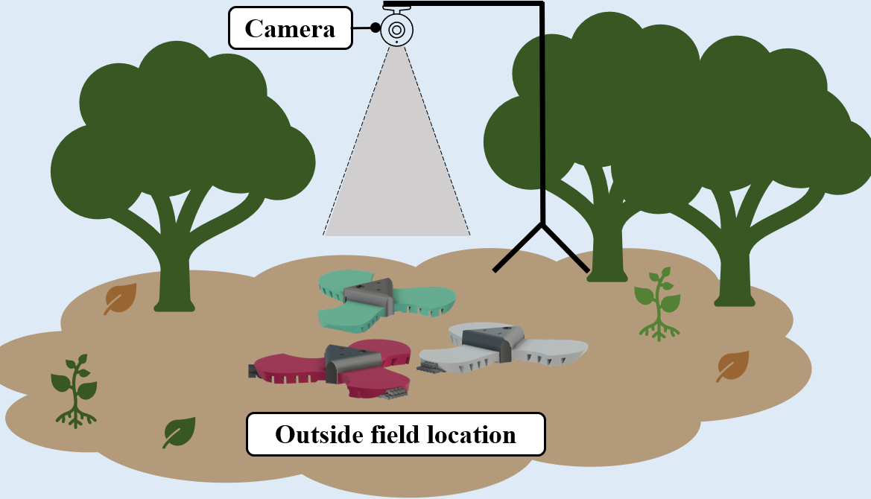
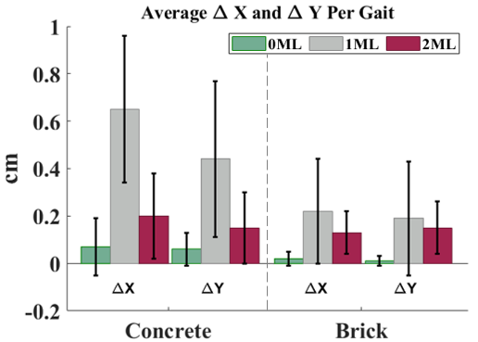
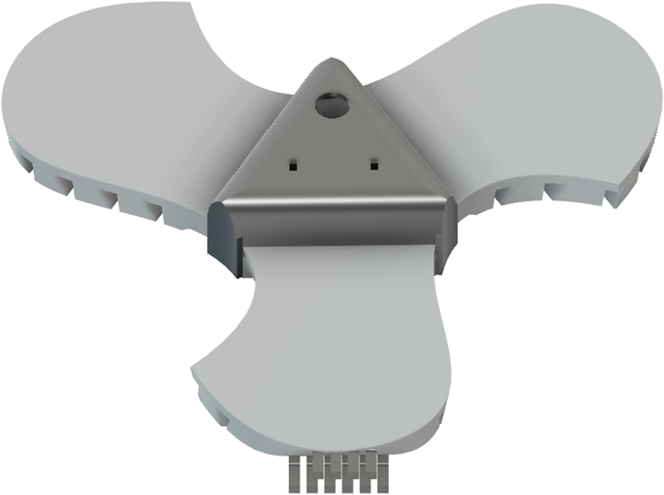
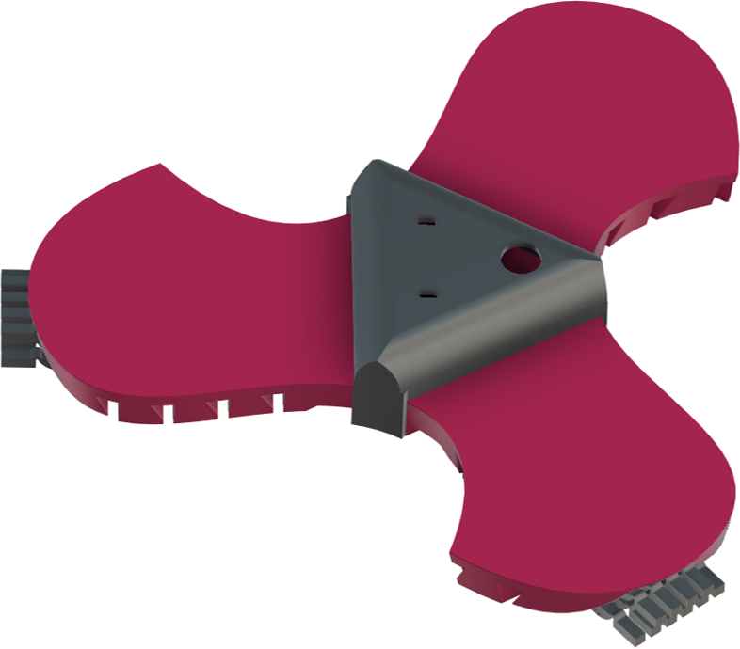


Improving Grip Stability Using Passive Compliant Microspine Arrays for Soft Robots in Unstructured Terrain
Lauren Ervin, Harish Bezawada, and Vishesh Vikas
Agile Robotics Lab, The University of Alabama
Introduction and Motivation
Compliant Microspine Mechanism
SoRo Mechatronics
Microspine grippers are small spines commonly found on insect legs that reinforce surface interaction by engaging with asperities to increase traction. Integrating an array of these microspines into the limbs or undercarriage of a robot can increase its ability to maneuver uneven terrains, traverse inclines, and even climb walls. Conformability and adaptability of
There are three critical design parameters that impact the effectiveness of the microspine mechanism:
Integrating compliance into individual mechanisms and the microspine surface contact angle,
Joining with the robot body, or soft-hard stiffness integration, and
The microspine array configuration.
The compliant microspine mechanism is fabricated with a TPU via FDM additive manufacturing. An exposed elbow joint in Fig. 2a provides passive compliance while interacting with the terrain. Embedded in the center of the design is a channel where a microspine is inserted halfway through the print. The holes in Fig. 2b facilitate mechanical anchoring with the limbs of a SoRo.
A tetherless, three limb motor tendon actuated (MTA) SoRo is used as the experimental prototype. The major components of the mechatronics are shown in Fig. 4. Each limb is actuated using a tendon connected to a DC motor fixed at the base of the central hub which enables limb curling. The central PCB controls all electronics and is powered with a LiPo battery. Three of these robots are utilized with differing combinations of microspine arrays, but all of them contain AprilTags on each limb to aid in overhead tracking during field tests.
Fig. 1: Microspine Motivation in Unstructured Terrain
Soft Robots (SoRos) makes them ideal candidates for these applications involving traversal of complex, unstructured terrains highlighted in Fig. 1. However, there remains a real-life realization gap pertaining to their transition from controlled lab environment to the real world. This can be addressed by improving grip stability through effective integration of microspines.
Contributions: We present a passive, compliant microspine mechanism that enhances the locomotion capabilities of mobile SoRos.
We offer a standardized microspine array integration method with soft-compliant stiffness integration, and reduced complexity resulting from a single actuator passively controlling them.
We explore different configurations of the microspine array to account for changing surface topologies and enable independent, adaptable gripping of asperities per microspine.
We perform field experiments with three robots on four outside surfaces and tracking results show that the microspines consistently improve locomotion repeatability and terrain traversability.
Fig. 3: Two-Row Microspine Array
The presented design utilizes a two-row, stacked microspine array configuration shown in Fig. 3. This grouping offers additional gripping capabilities on extremely steep/irregular surfaces from the top row while not hindering the effectiveness of the more frequently active bottom row. Crucially, not all microspines must interact with a surface for the microspine array to be effective. The number changes with the surface contact angle and roughness.
Fig. 2: Compliant Microspine Mechanism
Fig. 4: SoRo Mechatronics
Field Experiments
Results
Prototypes: 0ML (baseline), 1ML (microspine array on one limb), and 2ML (microspine arrays on two limbs) in Fig. 5.
Field tests were performed on four different surfaces:
1. Concrete 2. Brick 3. Compact sand 4. Forest floor
A nonoptimal push-pull translation gait sequence with actuation of one limb followed by actuation of the two relaxed limbs is used for all trials.
Three trials (60 gaits per trial) are performed per prototype (three total) and surface (four total), resulting in a total of 36 trials with overhead tracking shown in Fig. 6.
All planar locomotion experiments validate the benefits of the compliant microspine array. The adaptive nature of mobile SoRos provide potential for navigating unstructured environments, and the intelligent integration of compliant microspines gets them one step closer through increased grip stability, surface interaction, and terrain traversability.
The translation results of 0ML, 1ML, and 2ML are compared on four surfaces with an example of the path of each prototype on each surface provided in Fig. 7. Fig. 8 shows the average displacement and standard deviation of the three trials per prototype/surface combination. On concrete, 1ML had an average displacement of 39.63cm which is over 30 times as much as the 1.32cm that 0ML traveled. 2ML traveled 14.13cm, nearly 11 times as much as 0ML. 1ML traveled ~25 times more than and 2ML 18 times more than 0ML on brick. All SoRos struggled in sand, but both 1ML and 2ML overcame obstacles on the forest floor that blocked 0ML.
Fig. 8: Average Displacement
0ML
For each of the 36 trials, the robots move for 60 gaits, resulting in a total of 2,160 gaits. Each gait results in relative change in position (∆X, ∆Y) in the robot c.s. The consistency is analyzed by examining the ∆X, ∆Y for every gait shown in Fig. 9a). The displacement per gait is visualized in Fig. 9b). The relative standard deviation for 1ML and 2ML is lower than 0ML, indicating improved grip and repeatability.
1ML
2ML
Fig. 6: Experimental Setup
Fig. 9: Gait Analysis
Fig. 5: SoRos
Fig. 7: Experimental Qualitative Results
This work is supported in part by NASA grant #80NSSC20M0044 awarded to the Alabama Space Grant Consortium.

Slide 2
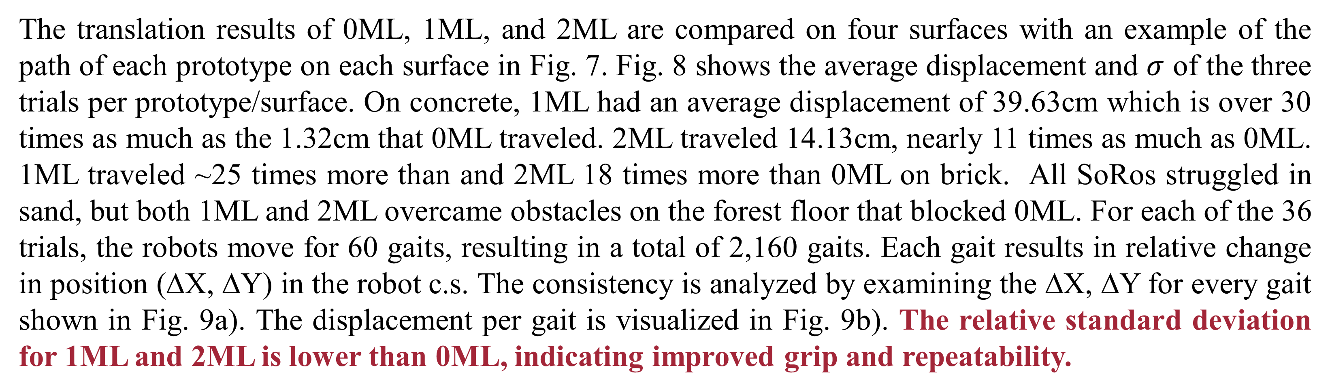
Improving Grip Stability Using Passive Compliant Microspine Arrays for Soft Robots in Unstructured Terrain
Lauren Ervin, Harish Bezawada, and Vishesh Vikas
Agile Robotics Lab, The University of Alabama
Introduction and Motivation
Compliant Microspine Mechanism and Array Integration
Microspine grippers are small spines commonly found on insect legs that reinforce surface interaction by engaging with asperities to increase traction. Integrating an array of these microspines into the limbs or undercarriage of a robot can increase its ability to
There are three critical design parameters that impact the effectiveness of the microspine mechanism shown in Fig. 2:
Mechanism compliance and surface contact angle,
Soft-hard stiffness integration, and
The microspine array configuration.
The design utilizes a two-row, stacked microspine array configuration shown in Fig. 3. This grouping offers additional gripping capabilities on steep/irregular surfaces from the top row without hindering the effectiveness of the more frequently active bottom row. Crucially, not all microspines must interact with a surface for the array to be effective. They are integrated into SoRos shown in Fig. 4.
Fig. 1: Microspine Motivation in Unstructured Terrain
maneuver uneven terrains, traverse inclines, and even climb walls. There remains a real-life realization gap pertaining to Soft Robots’ (SoRos’) transition from controlled lab environment to complex, unstructured terrains, shown in Fig. 1, that can be addressed by improving grip stability through the integration of microspines.
Contributions: We present a passive, compliant microspine mechanism that enhances the locomotion capabilities of mobile SoRos.
We define a soft-compliant SoRo-microspine array integration method.
We enable independent, adaptable gripping of asperities per microspine with reduced complexity via a single actuator.
We perform field experiments with three robots on four surfaces. Tracking results indicate microspines improve both repeatability and traversability.
Fig. 3: Two-Row Microspine Array
Fig. 2: Compliant Microspine Mechanism
Fig. 4: Compliant Microspine Mechanism
Field Experiments
Results
Prototypes: 0ML (baseline), 1ML (array in one limb), and 2ML (arrays in two limbs) in Fig. 5.
Field tests were performed on four different surfaces:
1. Concrete 2. Brick 3. Compact sand 4. Forest floor
A push-pull translation gait with actuation of one limb followed by the two relaxed limbs is used for all trials.
3 trials (60 gaits/trial) are performed per prototype (three total) and surface (four total), resulting in a total of 36 trials with tracking shown in Fig. 6.
Experiments validate the benefits of the microspine array. The adaptable SoRos show potential for navigating unstructured environments, and the integration of microspines gets them closer through increased grip stability and terrain traversability.
The translation results of 0ML, 1ML, and 2ML are compared on four surfaces with an example of the path of each prototype on each surface in Fig. 7. Fig. 8 shows the average displacement and $σ$ of the three trials per prototype/surface. On concrete, 1ML had an average displacement of 39.63cm which is over 30 times as much as the 1.32cm that 0ML traveled. 2ML traveled 14.13cm, nearly 11 times as much as 0ML. 1ML traveled ~25 times more than and 2ML 18 times more than 0ML on brick. All SoRos struggled in sand, but both 1ML and 2ML overcame obstacles on the forest floor that blocked 0ML. For each of the 36 trials, the robots move for 60 gaits, resulting in a total of 2,160 gaits. Each gait results in relative change in position (∆X, ∆Y) in the robot c.s. The consistency is analyzed by examining the ∆X, ∆Y for every gait shown in Fig. 9a). The displacement per gait is visualized in Fig. 9b). The relative standard deviation for 1ML and 2ML is lower than 0ML, indicating improved grip and repeatability.
0ML
1ML
2ML
Fig. 6: Experimental Setup
Fig. 9: Gait Analysis
Fig. 5: SoRos
Fig. 7: Experimental Qualitative Results
Fig. 8: Average Displacement
This work is supported in part by NASA grant #80NSSC20M0044 awarded to the Alabama Space Grant Consortium.

Slide 3
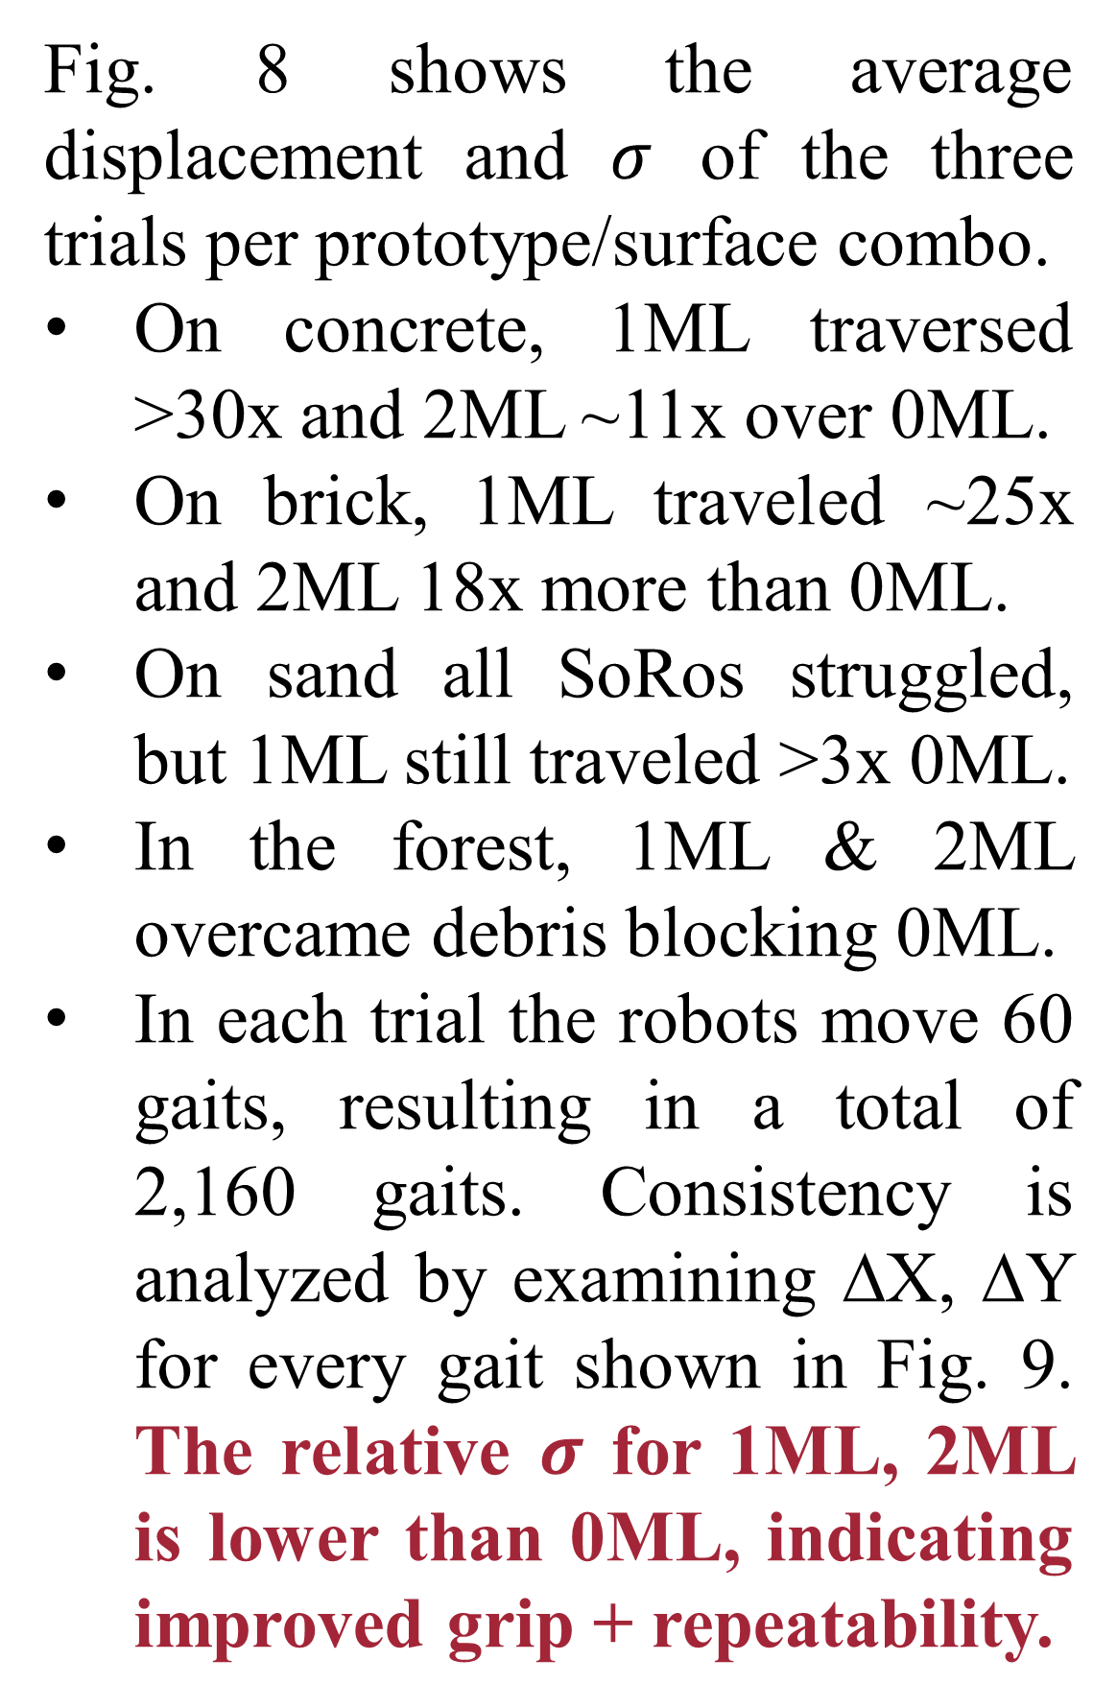
Improving Grip Stability Using Passive Compliant Microspine Arrays for Soft Robots in Unstructured Terrain
Lauren Ervin, Harish Bezawada, and Vishesh Vikas
Agile Robotics Lab, The University of Alabama
Introduction and Motivation
Compliant Microspine Mechanism and Array Integration
Field Experiments
Microspine grippers are small spines commonly found on insect legs that reinforce surface interaction by engaging with asperities [1-3]. An array of these microspines fixed to the limbs or
There are three critical design parameters that impact the effectiveness of the microspine mechanism shown in Fig. 2:
Mechanism compliance and surface contact angle,
Soft-hard stiffness integration, and
The microspine array configuration.
The design utilizes a two-row, stacked microspine array configuration shown in Fig. 3. This grouping offers additional gripping capabilities on steep/irregular surfaces from the top row without hindering the effectiveness of the more frequently active bottom row. Crucially, not all microspines must interact with a surface for the array to be effective. They are integrated into SoRos shown in Fig. 4.
Field tests were performed on four different surfaces:
1. Concrete 2. Brick
3. Sand 4. Forest floor
A push-pull translation gait (actuation of one limb then the other two) is used [4].
3 trials (60 gaits/trial) are performed per prototype (three total) and surface (four total), resulting in a total of 36 trials with tracking shown in Fig. 5.
Fig. 1: Microspine Motivation in Unstructured Terrain
undercarriage of a robot can increase its ability to maneuver uneven terrains. There remains a real-life realization gap for Soft Robots’ (SoRos’) transition from controlled environment to complex terrains, shown in Fig. 1, that can be addressed by improving grip stability through the integration of microspines.
Contributions: We present a passive, compliant microspine mechanism that enhances the locomotion capabilities of mobile SoRos.
We define a soft-compliant SoRo-microspine array integration method.
We enable independent, adaptable gripping of asperities per microspine with reduced complexity via a single actuator.
We perform field experiments with 3 robots on 4 surfaces. Tracking indicates microspines improve both repeatability and traversability.
Fig. 3: Two-Row Microspine Array
Fig. 2: Compliant Microspine Mechanism
Fig. 4: SoRo Mechatronics
Fig. 5: Experimental Setup
Qualitative Results
Quantitative Results
References
Experiments validate the integration of the compliant microspine array
1. increases grip stability 2. surface interaction 3. terrain traversal.
Three prototypes: 0ML (baseline), 1ML (array in one limb), and 2ML (arrays in two limbs) in Fig. 7.
Fig. 8 shows the average displacement and $σ$ of the three trials per prototype/surface combo.
On concrete, 1ML traversed >30x and 2ML ~11x over 0ML.
On brick, 1ML traveled ~25x and 2ML 18x more than 0ML.
On sand all SoRos struggled, but 1ML still traveled >3x 0ML.
In the forest, 1ML & 2ML overcame debris blocking 0ML.
In each trial the robots move 60 gaits, resulting in a total of 2,160 gaits. Consistency is analyzed by examining ∆X, ∆Y for every gait shown in Fig. 9. The relative $σ$ for 1ML, 2ML is lower than 0ML, indicating improved grip + repeatability.
[1] Sangbae Kim, M. Spenko, S. Trujillo, B. Heyneman, D. Santos, andM. Cutkosky, “Smooth Vertical Surface Climbing With DirectionalAdhesion,” IEEE Transactions on Robotics, vol. 24, no. 1, pp. 65–74,Feb. 2008.
[2] A. T. Asbeck and M. R. Cutkosky, “Designing Compliant SpineMechanisms for Climbing,” Journal of Mechanisms and Robotics,vol. 4, no. 3, p. 031007, Aug. 2012.
[3] P. Nadan, S. Backus, and A. M. Johnson, “LORIS: A Lightweight Free-Climbing Robot for Extreme Terrain Exploration,” ICRA, pp. 18480–18486, May 2024, doi: 10.1109/icra57147.2024.10611653.
[4] C. Freeman, A. N. Mahendran, and V. Vikas, “Environment-centriclearning approach for gait synthesis in terrestrial soft robots,” 2024.[Online]. Available: https://arxiv.org/abs/2402.03617
0ML
1ML
2ML
Fig. 7: Three Prototype Array Configurations
Fig. 6: Experimental Qualitative Results
Fig. 8: Average Displacement
Fig. 9: Gait Analysis
This work is supported in part by NASA grant #80NSSC20M0044 awarded to the Alabama Space Grant Consortium.

